Slide 1
Comet Fuel Saving System

Slide 2
SAVE
5-20%

Slide 3
HOW ?

Slide 4
Comet Consulting Group presents
the Comet Fuel Saving System (CFSS) - an unique system for monitoring, control and reduction of consumption of all types of fuels (petrol, diesel, propane and other oil derivates, both liquid and gas).

Slide 5
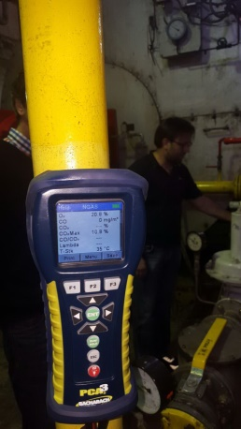
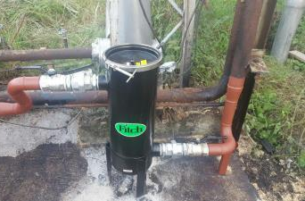
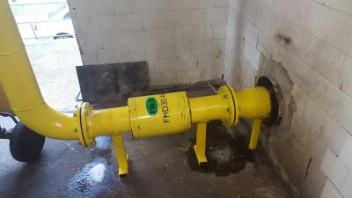
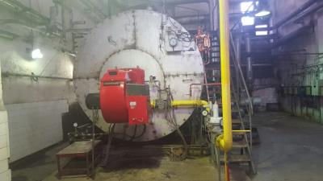
The fuel saving system also contains reformulators (patented in the USA) which, at molecule level, carry out homogenization and reformulation of fuel, by which they increase octane or cetane value, and completely remove carbon build up (practically no modification is required to boilers because there is no build up and energy is used efficiently).
The guaranteed saving on gas installations is 5%, while with LPG, oil, fuel oil and petroleum the saving is 12-15%, in practice reaching an entire 20% in savings.

Slide 6
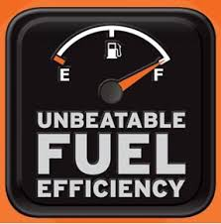
Why choose Comet Fuel Saving System?
FUEL SAVING - CFSS reformulates all types of fuel (petrol, diesel, heating oil, propane) resulting in significant fuel consumption reduction
HIGHER EFFICIENCY - Reformulated fuel burns better and produces more energy
ECO FRIENDLY – Significantly reduces smoke, sooth and greenhouse gases
RETURN OF INVESTMENT period (ROI) is in most cases shorter than one year
EASILY INSTALLED, maintenance free and works for years to follow
In New York solely, there are close to 1000 commercial
applications of this technology

Slide 7
The Comet Fuel Saving and Fleet Management System
The Comet fuel saving and fleet management system (CFSS) is the perfect solution for reducing the overall transportation and stuff costs and a powerful tool in the hands of company management.

Slide 8
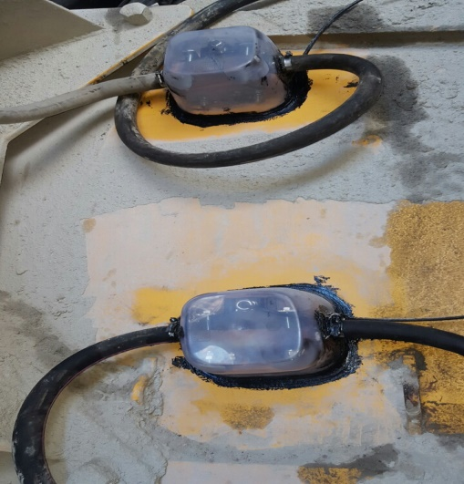
CFSS implementation guarantees fuel costs reduction and simplyfies planing, monitoring and fine tuning of different cost-affecting functions. That is accomplished by combined action of following components:
The CS fuel homogenisation and reformulation unit – a compact catalyst device that enables better fuel combustion, resulting in permanent fuel consumption reduction
The CS fuel tank control unit – prevents unauthorised fuel transfer
The CS tracking unit – enables real time GPS vehicle tracking; may include panic button and/or black box options.

Slide 11
The CS Catalyst Unit (CSCU) is a non-mechanical, maintenance free device. It is installed within the fuel line, between the fuel tank and the engine. The inside of CSCU consists of a patented mixture of metallic alloys that, when exposed to any hydrocarbon-based fuel, constructively modifies molecular sequence and structure of that fuel, resulting in more efficiant combustion and consequently respectable energy savings.
When properly installed, CSCU deliveres fuel efficiency improvement of at least 5% for gas fuels and at least 12% improvement for liquid fuels; reduces greenhouse gas emission up to 60%; extends maintenance intervals and cuts affiliated costs; prolongs motor oil life and life of motor itself.

Slide 13
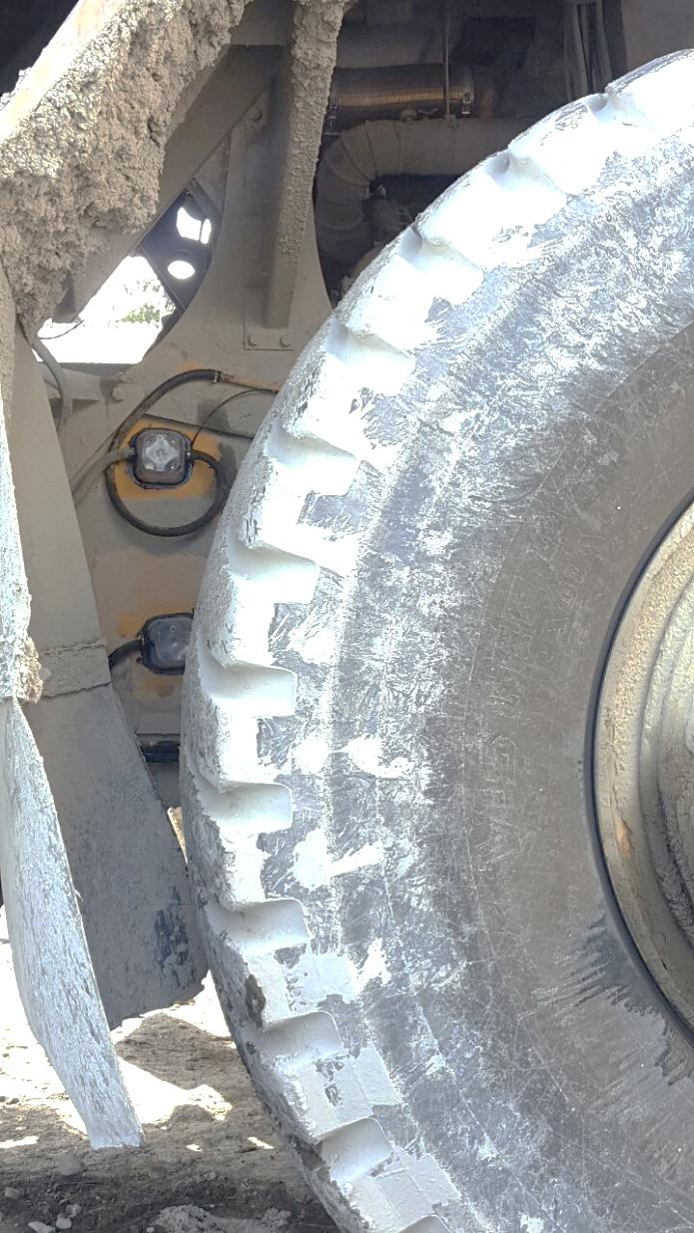
In selected fleet vehicle a compact yet robust CS tracking unit (CSTU) is installed in a way that it does not change neither vehicle’s enterior nor engine performance.
This device uses GPS system for vehicle location and GSM network for real time data transfer to head office.
Different fleet management functions, such as vehicle telematics (tracking and diagnostics), routing, dispatching, speed and fuel management, driving behavior (itinerary, detours and stops), various on-board information or security status, can be monitored and fine-tuned.
Warranty on CSTU functionality expands over the entire period defined by contract. Technical support and crew training are included.

Slide 15
CFSS implementation also brings following advantages:
Accurate fuel level tracking for theft prevention and fuel consumption evidention and planning
Transport optimization through the control of given tasks, routes, locations and deadlines
Mileage, itinerary and engine hours reading in any time interval, thus reducing administration costs
SMS warning / e-mail report if vehicle leaves predefined route or is used out of business hours, thus preventing vehicle misuse or theft
Overtime costs reduction
In the case of emergency – by using the panic button in emergency situations a command center is instantly alarmed
In case of traffic accidents a report is sent containing precise vehicle GPS location, sensors status and impact speed. Generated data analysis enables an accident reconstruction
When vehicle alarm is activated, a built-in device alerts the client by sending a sms message or by making a telephone call.
Guaranteed savings in a system with strictly controlled fuel consumption are minimum 5 %, while our best result so far was fuel savings of 27 %.

Slide 16
Features & Benefits
Fuel Catalyst works well on the following hydrocarbon fuels:
Gasoline, E10, E85
Diesel
Bio-diesel
Propane
#2, #4, #6 heating oil
MDO & Bunker C

Slide 17
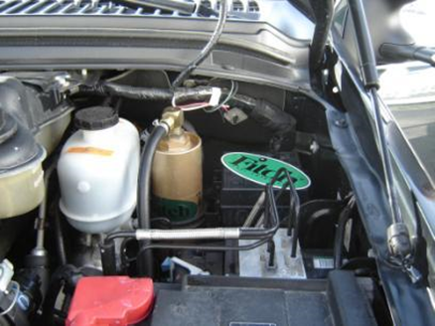
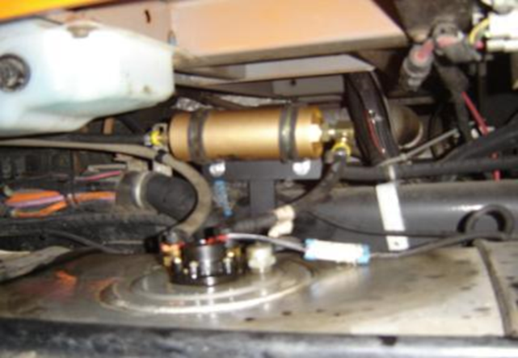
Fuel Catalyst is helpful to all internal combustion engines
Keeping Fuel Fresh and Engine Performance Crisp
Increasing Fuel Economy, 1 to 2.5 MPG
Reducing Smoke and Exhaust Emissions
Increasing HP and Torque
Reducing Maintenance, Internal Carbon Buildup, Plug and Injector Fouling
Making Low Octane Fuel Perform like Premium
Reducing or Eliminating Nuisance Ping and Engine Knock
Eliminating the need for additives of all kinds including octane boosters and stabilizers
Eliminates bacteria growth

Slide 18
Customers
Fortune 500 Companies, Institutions, Municipalities
US Navy (NAVFAC) contact - Ralph Herring (ret) (805) 797-4911
Air Force National Guard contact -Tony Labelle Pease AFB,603-430-3478
New York City Housing Authority – Frank Romano , Energy Ops (212) 306-4687
New York City Schools
Verizon Communications
Vodafone Communications
Marquette Transportation
Honda Siel Automotive
Honda Manufacturing, Thailand
Phillips Electronic
Conoco Philips
Grand Hyatt Resort
Sheraton Resort
Constellation Energy Power Plant
CSX Railways

Slide 19
Recommendations

Slide 20
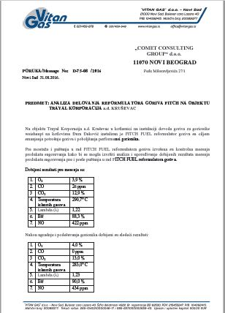
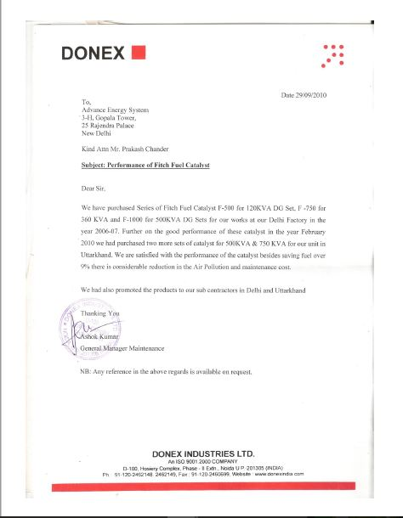
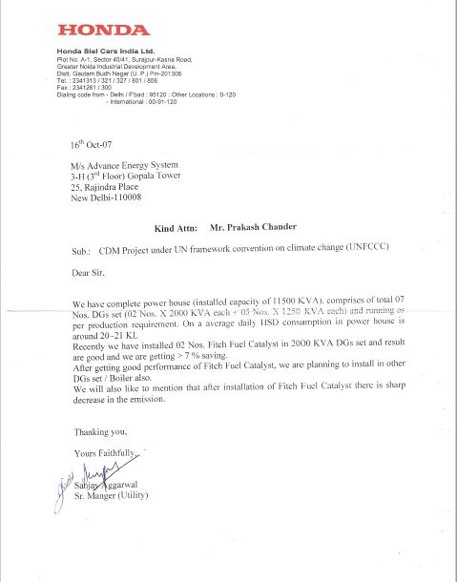
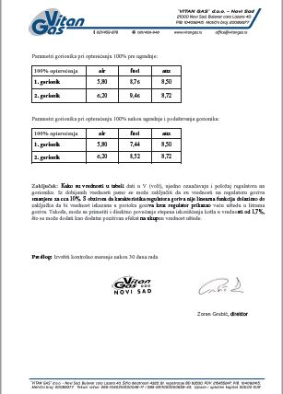

Slide 22
Thank you

